Slide 1


Peak Performance
Build Your Best Year
Manage your time and energy in order to achieve your goals.
Notes:
Peak performance = performing with the best of your ability, building a framework for your life of continuous improvement, the moment when you “put it all together” and are working in your “flow zone” to reach optimal performance.
Why peak performance? Understanding the concepts of peak performance tie into all aspects of Wellness or “Building Your Best You”
Some people relate more to these concepts more so than when they hear the word “wellness” or “health”

Slide 2

Building the path to success
A key factor of success is building the path to be your best in the moments that truly count
Being our best when it matters takes practice
Researching or writing papers
Delivering a presentation
While playing a sport
When a friend or family member needs you
When having a difficult conversation
On an internship or job interview
Taking an exam
On a first date
When do you want to be your best?
Notes:
A key factor of success is building the path to be at your best in the moments that truly count.
We can’t be our best in every moment of the day, but we will talk about the 6 defining aspects of peak performance that can help us.
With that being said, being our best when it matters takes practice!
Ask students: What are some times you want to be your best?
Sometimes it seems like a right of passage of sorts to become overly stressed, lacking sleep, proper nutrition or adequate time to unwind.

Slide 3
Awareness
Visualization
SMART goals
Motivation
Positive affirmations
How can we practice being our best?
Refocusing
Self-talk
Growth mindset
Emotional regulation
Notes:
There are 6 defining aspects of peak performance/being our best - SMART goals, Motivation, Visualization, Refocusing, Self-talk, Emotional regulation
Note that not one is more important than the other, all equally important and work together

Slide 4
Motivation
The psychological push or force that activates or maintains a behavior
Our confidence in our abilities
Our expectations about the outcome
Finding value in what we do
Practice these three things to improve your motivation!
Notes:
What motivates you? What ignites your fire? Do your values, confidence and outcome expectations align with your goals?
Often one of these things is lacking so we can address that to improve our motivation and likelihood of success
Outcome expectations - belief about the likelihood of your actions/behaviors leading to a certain outcome
Think of something that has been challenging for you over the past few months:
Do you have confidence that you can tackle this challenge?
Do you believe the outcome is possible and productive? Do you see a clear path to the outcome?
Is conquering this challenge in-line with your own personal goals and values?

Slide 5
Visualization
Creating an experience in your mind
What percentage of your game is mental?
Visualization increases your chances of achieving your goals
Notes:
Visualization = creating an experience in your mind. Before we achieve a goal, we have to have an idea of what it looks like
Visualization has been shown to improve athletic performance by improving motivation, coordination and concentration; it also aids in relaxation and helps reduce fear and anxiety. These same skills can transfer over to academic and work performance, and even in your personal life and relationships.
Brain imagery research shows that visualization works because the neurons in our brains interpret imagery the same as the do real-life action. When we visualize, the brain generates an impulse that tells our neurons to “perform” the movement. This creates a new neural pathway, which gets our body ready to act in a way consistent to what we imagined. Pay attention to detail, use all of your senses, focus on images and abilities of importance, include success in the task and overcoming smaller obstacles along the way
What part of your “game” is mental (vs. intellectual)? Now, how often do you practice that (vs. study)?

Slide 6
Refocusing
Remind yourself that one does not lose focus, rather it is somewhere else
Practice mindfulness:
Set an intention
Increase awareness when focus shifts
Have cue-words to get you back on track
Work in intervals (Pomodoro method)
Stay focused and keep moving forward!
Notes:
Time and energy are not infinite, so we must be mindful about how we use them
In order to focus your time effectively, maintain a calendar or system that works for you
In order to manage your energy and attention effectively, identify your strengths and weaknesses
When are you most alert and energized? Take advantage of those periods of time
How do you want to spend your time, energy and focus?
(ball throwing exercise)
School, work, socialization, family… Unless you plan for it, a ball will most likely drop
One way to effectively manage both time and energy is by practicing the pomodoro method: Take away any guesswork and abstract goals by using the timer
Set aside 1-2 hours of time
The technique uses a timer to break down work into intervals, traditionally 25 minutes in length, separated by short breaks.
25 on, 5 off, 25 on, 5 off, 25 on, 5 off, then a longer break every 1 or 2 hours. During this time, challenge yourself to immerse your focus and energy on the task at hand. Get a drink, use the restroom, check your phone, etc. during breaks
How else do you manage your time and energy?

Slide 7

Self-talk
Self-talk can be a powerful form of communication. It can empower you or defeat you - you choose!
Use positive and realistic affirmations
Practice growth mindset
Use self-talk prior to important events
Be mindful of the way you talk to yourself
Notes:
Self-talk - the way you talk to yourself, either in your head or aloud
Think of a time when you received a genuine or meaningful compliment. Why not do that for yourself?
Growth mindset - all things can be developed, sees failure not as evidence of unintelligence but as an opportunity for growth, thrives on challenge - you can change and grow through experience
vs. fixed mindset - assumes our intelligence and ability are fixed characteristics, and failures are shameful. Expects good things to happen automatically without working
Practicing gratitude can help reframe and put you in the right headspace

Slide 8
Emotional regulation
The ability to realize, readily accept and successfully control our feelings
Identify specific feelings
Determine healthy, effective ways to cope
Try to reframe negative feelings into a growth opportunity
Take a deep breath and keep moving forward!
Notes:
It’s completely normal to feel stressed, it’s how we manage that stress that matters. Everyone has their own ways of managing stress.
It’s important to recognize emotions so that they can be effectively managed
Identify and reflect on emotions when they start to impede your ability to do your best work
Why am I (sad, stressed, angry…)?
What can I do about the event or issue that is contributing to this emotion?
People who are emotionally healthy are more resilient, meaning that they are able to bounce back from difficulties faster.
To strengthen your emotional wellness, remember your good deeds and give yourself credit for them.
Forgive yourself for mistakes and try not to dwell on what went wrong.
With self-affirmation, you will be more equipped to deal with negativity when (not if) it arises.
What are some of the strategies you all use to cope with stress or other emotions?
Give yourself a period of time to work through the feeling rather than suppressing it, as it will likely surface again if it’s not managed

Slide 9
SMART goals
For a goal to be powerful, it must be designed SMART. Set Specific, Measurable, Actionable, Relevant and Time-bound goals.
Create short- and long-term goals
Give yourself appropriate rewards for achieving small goals
Be flexible with yourself and the goals you create
What are some of your SMART goals?
Notes:
It’s important to note that doing your best at something doesn’t just happen, it often starts as a goal/number of small goals/action steps we do to help us perform our best
Go over what each letter means SMART goal
Write down or share your own short and long term goals

Slide 10
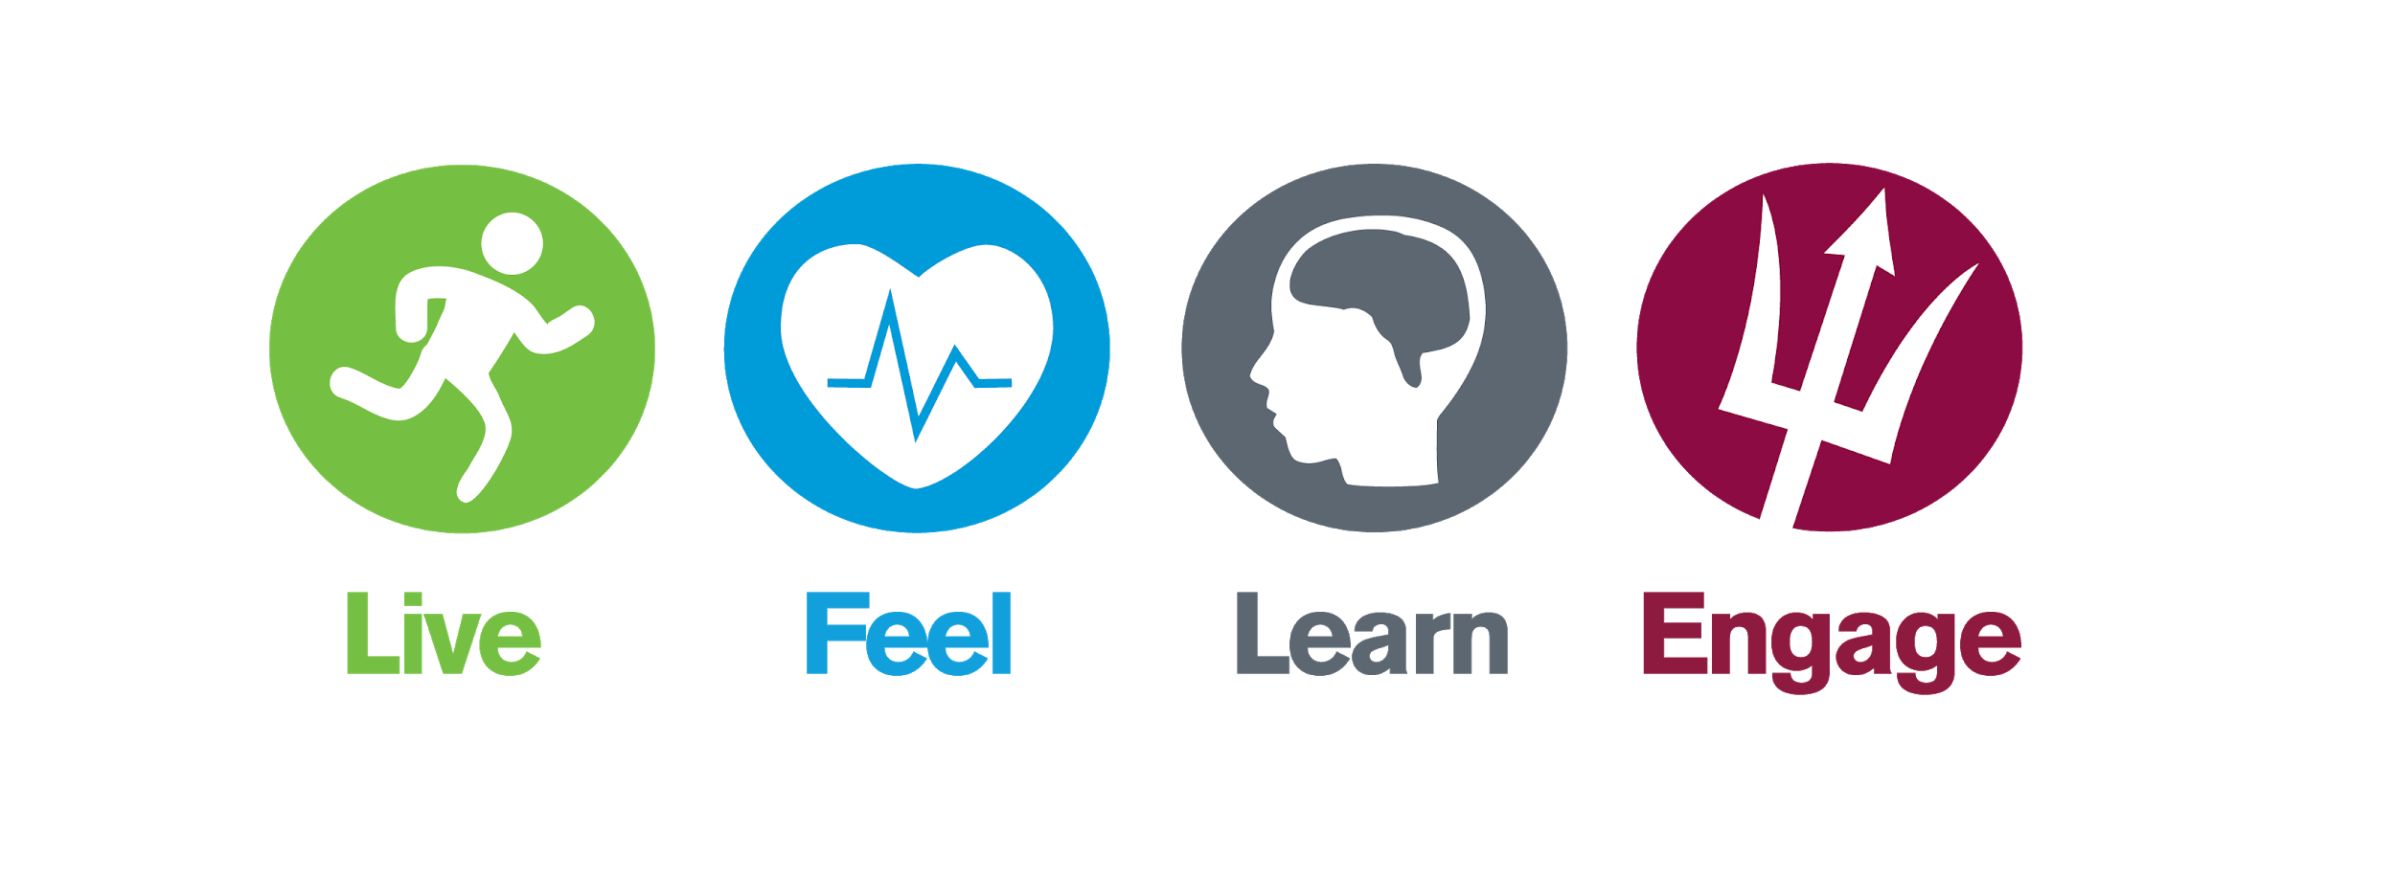

Questions?
Alyssa Sanonu, M.Ed
Health Educator Senior, Wellness@ASU
Alyssa.Sanonu@asu.edu
Notes:
These concepts can be tied into all aspects of Wellness - how can you use them to build your best you?
No one skill is more important than another, they work together

Slide 11
Brought to you by:
wellness.asu.edu

